Slide 1
NSF Budget / Congressional Update NSF Business & Operations Advisory Committee November 29, 2016
Michael Sieverts
Division Director, Budget Division
Office of Budget, Finance, and Award Management
Anthony Gibson
Senior Advisor, Office of Legislative and Public Affairs

Slide 2
NSF Appropriations FY 2000 – FY 2016 (Millions of Current Dollars)
5% average growth from FY 2000 to FY 2009
1% average growth from FY 2010 to FY 2016
*FY 2009 excludes $3,002 million for ARRA.

Slide 3
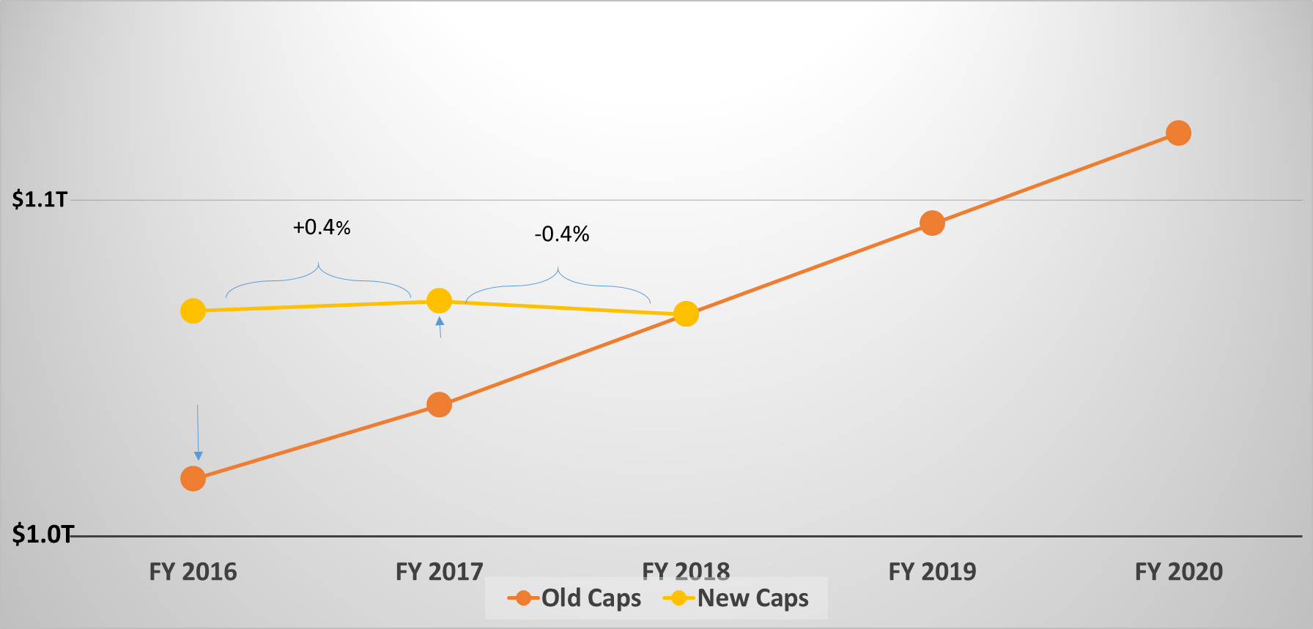
Bipartisan Budget Act of 2015 (P.L. 114-74)
Discretionary Budget Caps
+3%
+5%

Slide 4
NSF FY 2017 Budget Request to Congress

Slide 5
FY 2017 NSF Funding Comparisons
$7.6 B – Request (Discretionary)
$8.0 B – Total Request (inc. $400 M mandatory)
$7.4 B – House
$7.5 B -- Senate
$7.5 B – FY 2016 Enacted

Slide 6
What is meant by mandatory funding?
Different category of Federal spending than NSF typically sees
Also known as “direct spending”
GAO Definition: budget authority that is provided in laws other than appropriations acts
Most commonly associated with entitlement programs (Social Security, Medicare, etc.) but also supports R&D
Not subject to discretionary caps
In FY 2017, the Administration is seeking legislation to provide mandatory funding for NSF on a one-time basis
Notes:
Slide 4: Michael

Slide 7
FY 2017 Status
Continuing Resolution through Dec. 9
Enacted Sept. 29, 2016
P.L. 114-223
Congress to return after election to complete action on FY 2017

Slide 9
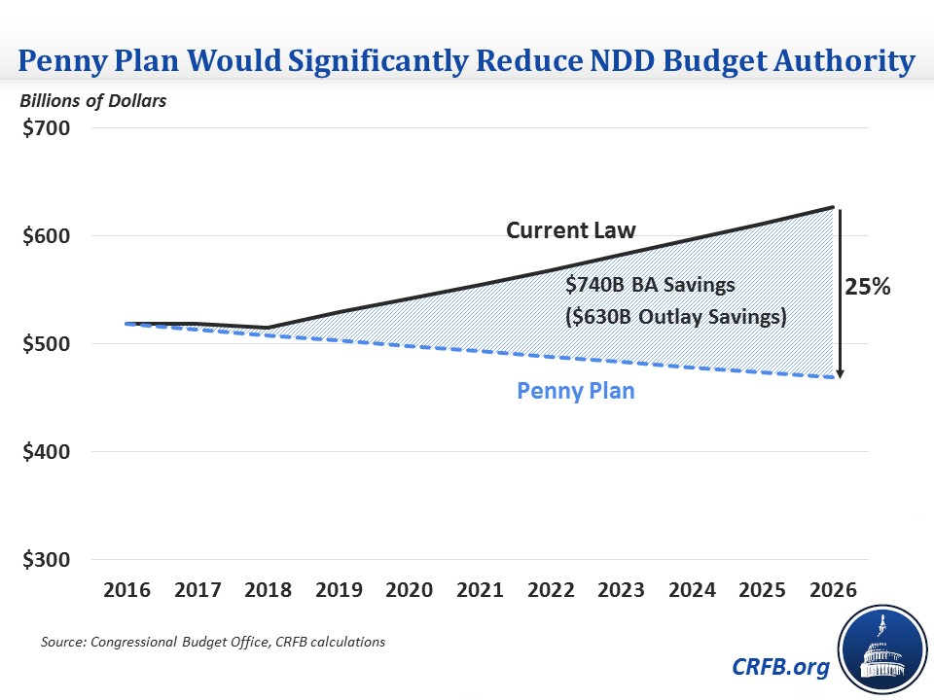

Slide 10
2016 Election Results
SENATE | 114th Congress | 115th Congress - 2016 Election Results* | Change**
Republicans | 54 | 51 | -3 seats
Democrats | 46* | 48* | +2 seats
* 2 Independents caucus with Democrats
** Louisiana will hold a runoff election on December 10, 2016
HOUSE OF REPRESENTATIVES | 114th Congress | 115th Congress – 2016 Election Results** | Change**
Republicans | 247 | 238 | -9 seats
Democrats | 188 | 193 | +5 seats
** Four House races have not yet been called (including two House districts in Louisiana, which will hold a runoff election on December 10, 2016).

Slide 11
Senate
Republicans retain leadership of the Chamber
Maintain control over Committees, schedule/calendar, Executive nominations, treaties
Appropriations – Commerce, Justice, Science, and Related Agencies
Vice Chairwoman Barbara Mikulski (D-MD) has retired, Sen. Mark Kirk (R-IL) was not reelected
Authorizing – Commerce, Science, Transportation Committee
Subcommittee on Science, Space, and Competitiveness – no change*
Authorizing – Committee on Health, Education, Labor, and Pensions
Barbara Mikulski (D-MD) has retired, Sen. Mark Kirk (R-IL) was not reelected

Slide 12
House of Representatives
Republicans retain leadership of the Chamber
Maintain control over Committees, schedule/calendar, rules of business
Appropriations – Commerce, Justice, Science, and Related Agencies
Rep. David Jolly (R-FL) and Ranking Member Mike Honda (D-CA) were not reelected. Rep. Chaka Fattah (D-PA) resigned during the 114th Congress
Authorizing – Science, Space, and Technology Committee
Subcommittee on Research and Technology – Rep. Randy Neugebauer (R-TX) retired, Rep. Donna Edwards (D-MD) and Rep. Alan Grayson (D-FL) did not seek reelection

